Slide 1


Introduction to statistics using R
Seminar series - session 4

Slide 2
Session 4 – Learning objectives
Data wrangling – Part 1:
Revisions
Start an R session
Install packages
Load libraries
Load data
R objects

Slide 3
Session 4 – Learning objectives
Data wrangling – Part 1:
Data wrangling
Get organized
Know your data
Coerce
Your turn!

Slide 4
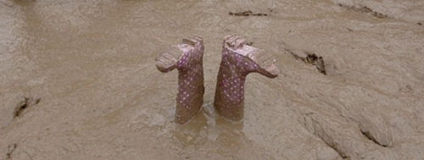
You’ll feel overwhelmed

Slide 5
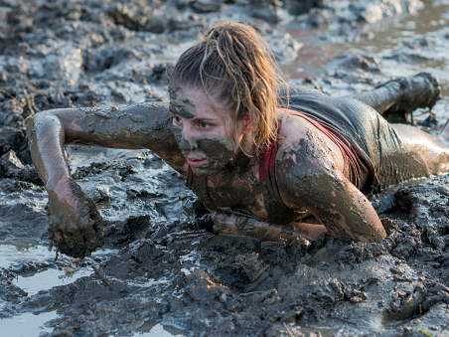
But that’s ok! If you take the time to practice, you’ll crawl your way out of the mud

Slide 6
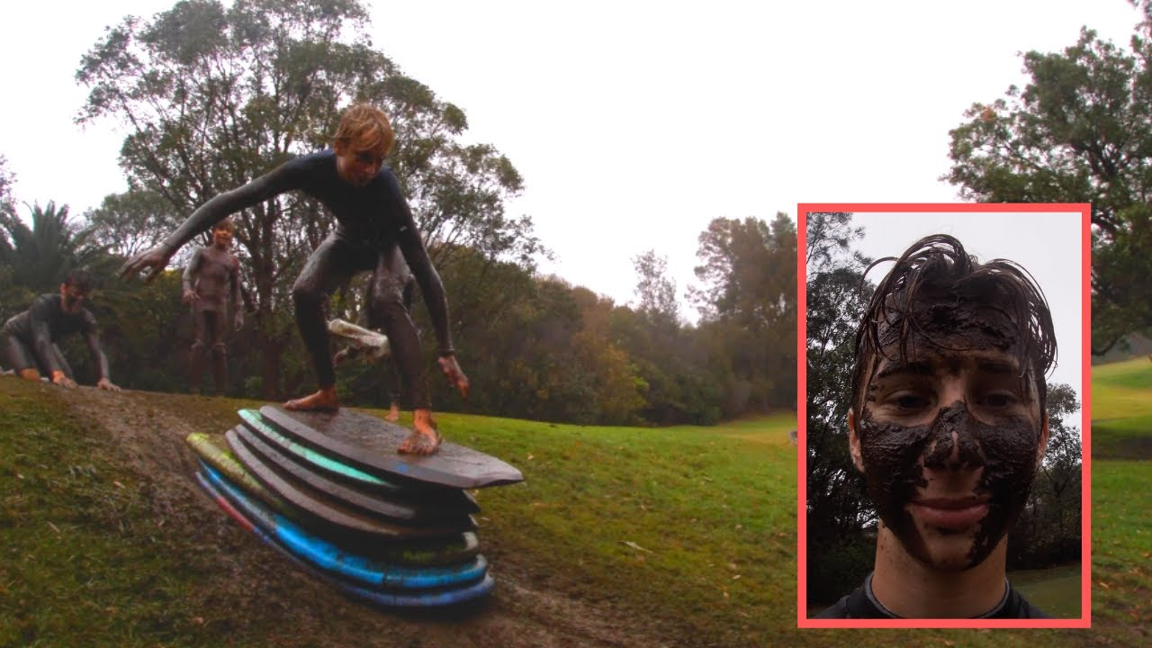
And some day, just like that, you’ll be an expert!

Slide 7
Tip 1
“Organization is what you do before you do something, so that when you do it, it is not all mixed up.”
- A. A. Milne

